Slide 1

IN-VEHICLE-COUPON-RECOMMENDATION
Project Guide: Ms.S.R SRIVIDHYA
Name of the Student: NAVAMSHU RAM PV
Register Number: 39110683

Slide 2
Presentation Outline
Course Certificate
Introduction
Objectives
System Architecture / Ideation Map
Module Implementation
Results and Discussions
Conclusion
References

Slide 3

Course Certificate

Slide 4
Introduction
Machine Learning (ML) is a branch of Artificial Intelligence(AI) which focuses on the use of data and algorithms to imitate the way that humans learn and gradually improving accuracy.
Decision tree learning or induction of decision trees is one of the predictive modelling approaches used in statistics, data mining and machine learning. It uses a decision tree (as a predictive model) to go from observations about an item (represented in the branches) to conclusions about the item's target value (represented in the leaves)
In the past years, research in the fields of big data analysis, machine learning and decision tree techniques is getting more frequent.
This thesis describes, decision tree is a popular application of supervised learning. Using decision tree, recommend coupon for customers to potential user base.

Slide 5
Introduction
Improvement in classification accuracy have resulted from growing an ensemble of trees and letting them vote for the most popular class.
The main goal of this project was to recommend and deliver a component that can be used by the user effectively.
The decision tree method discussed in this paper is based on the classification dataset. We undergo three different relationships between user and product. User-product relationship occurs when some users have an affinity or preference towards specific products that they need. Product-product relationships occur when items are similar in nature, either by appearance or description. User-user relationships occur when some customers have similar taste with respect to a particular product or service.
Problem Statement: The goal is to recommend coupon to a person, whether he will accept the coupon if he is the driver. (yes/no)

Slide 6
Objectives
The objective of the project is to find how to use supervised learning techniques for analysis and making predictions using existing dataset . To find how they can be used together in a process of converting raw data to effective decision-making knowledge. Building the predictive models will help to predict .
In the field of supervised learning, it is important to choose an algorithm well suited for the available dataset. To make this choice, projects that tackle similar problems and use similar techniques were analysed during the first step of the project. In this section, systems using different algorithms will be presented. The survey describes different driving scenarios including the destination, current time, weather, passenger, etc., and then ask the person whether he will accept the coupon if he is the driver.

Slide 7
Objectives
This report presents the different stage of data analysis such as data preparation and cleaning, building the models and model testing. Finally, the results of machine learning techniques are evaluated and analyzed.
Predicting the potential product to clients has always been a crucial challenge in attaining success for recommender system.
The available data is the most vital part of any test/train algorithm. The most important aspects are the quality and amount of the available data. To run some sort of similarity function to split items or users in a system, the data needs to be arranged into feature vectors with a set of feature values. To achieve the best results, a large amount of data is needed and more importantly the absence of data points needs to be minimal. The amount of data in most cases is not a problem nowadays since companies store all kinds of user and item data in large databases.

Slide 8
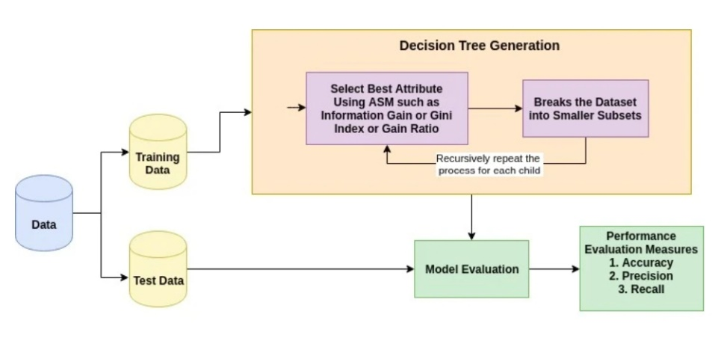
Objectives
With the inception of machine learning - reaching out to specific groups of people have been revolutionized by using data and analytics to provide detailed strategies to understand which customers are more likely to buy to a vehicle product.
In this project on VEHICLE-COUPON-RECOMMENDATION with machine learning, I will explain how a particular Dataset can use predictive analytics to help prioritize customers .

Slide 9
System Architecture
Import all necessary libraries
Analyze the result
Importing the dataset
Running the test cases of the program
Exploring data analysis(EDA)
Using decision tree classifier, for predicting model
Training the model using test/train split algorithm

Slide 10
Project Implementation
In this project I will demonstrate how to build a model predicting recommender system using decision tree in python using the following steps:
Data preparation
Exploratory data analysis
Analyzing the correlation to numerical features
Encode categorical features
Using machine learning decision tree algorithm for getting output

Slide 11
Project Implementation
In Python, Modules are simply files with the “.py” extension containing python code that can be imported inside another python program. In simple terms, we can consider a module to be the same as a code library or a file that contains a set of functions that you want to include in your application.
With the help of modules, we can organize related functions, classes, or any code block in the same file. So, It is considered a best practice while writing bigger codes for production-level projects in Data Science is to split the large Python code blocks into modules containing up to 300–400 lines of code.

Slide 12
Project Implementation
Hardware & Software Requirements:
8 GB RAM
Operating System
Windows 11,Core i5
Anaconda navigator along with python 3.8
About Dataset:
This data was collected via a survey on Amazon Mechanical Turk. The survey describes different driving scenarios including the destination, current time, weather, passenger, etc., and then ask the person whether he will accept the coupon if he is the driver.

Slide 13
Project Implementation
Step.1: Identifying the problem, collecting, describing the dataset
Step.2: Exploring, data cleaning and preparation
Step.3: Building the models
Step.4: Test and evaluate the performance of the models
The objective is to estimate the performance of the machine learning model on new data, data not used to train the model. There is no optimal split percentage, common split percentages include:
1. Train: 80%, Test: 20%
2. Train: 67%, Test: 33%
3. Train: 50%, Test: 50%

Slide 14
Project Implementation
How decision tree algorithm work?
Select the best attribute using Attribute Selection Measures(ASM) to split the records.Make that attribute a decision node and breaks the dataset into smaller subsets.
Starts tree building by repeating this process recursively for each child until one of the condition will match:
All the tuples belong to the same attribute value.
There are no more remaining attributes.
There are no more instances.

Slide 15
Project Implementation
True Positive (TP) is the number of correct predictions that an instance is true, or in other words; it is occurring when the positive prediction of the classifier coincided with a positive prediction of target attribute. True Negative (TN) is presenting several correct predictions that an instance is false, (i.e.) it occurs when both the classifier, and the target attribute suggests the absence of a positive prediction. False Positive (FP) is the number of incorrect predictions that an instance is true. Finally, False Negative (FN) is the number of incorrect predictions that an instance is false.

Slide 16
Project Implementation
Classification accuracy is defined as the ratio of the number of correctly classified cases and is equal to the sum of TP and TN divided by the total number of cases (TN + FN + TP + FP).
Accuracy=TP+TN/TN + FN + TP + FP
Precision is defined as the number of true positives (TP) over the number of true positives plus the number of false positives (FP).
Precision=TP/TP+FP
Recall is defined as the number of true positives (TP) over the number of true positives plus the number of false negatives (FN).

Slide 17
Project Implementation
Recall=TP/TP+FN
Sensitivity refers to the rate of correctly classified positive and is equal to TP divided by the sum of TP and FN. Sensitivity may be referred as a True Positive Rate
Sensitivity=TP/FN+TP
Specificity refers to the rate of correctly classified negative and is equal to the ratio of TN to the sum of TN and FP
Specificity=TN/TN+FP

Slide 18
Methodology
From digging deeply to analyze the columns, we see there are a mix of categorical (non-numeric) and numerical data. A few things to note:
1. All the data inputted are non-null values, meaning that we have a value for every column.
2. Age, gender, destination, passenger, temperature, occupation, income, etc.
3. Output (y) has two values: “yes” and “no”

Slide 19
Methodology
The train-test split is a technique for evaluating the performance of a machine learning algorithm. It can be used for classification or regression problems and can be used for any supervised learning algorithm. The procedure involves taking a dataset and dividing it into two subsets. The first subset is used to fit the model and is referred to as the training dataset. The second subset is not used to train the model; instead, the input element of the dataset is provided to model, then predictions are made and compared to the expected values. This second dataset is referred to as the test dataset.
1. Train Dataset: Used to fit the machine learning model.
2. Test Dataset: Used to evaluate the fit machine learning model.

Slide 20
Methodology
Validation Samples: These samples are held out from the training data and are used to make decisions on how to improve the model.
Test Samples: These samples are held out from all decisions and are used to test (measure) the generalized performance of the model
Using Decision Tree: Decision trees are very easy as compared to the random forest. A decision tree combines some decisions, whereas a random forest combines several decision trees. Thus, it is a long process, yet slow. Whereas a decision tree is fast and operates easily on large data sets, especially the linear one.

Slide 21
Methodology
RS-Adapted Decision Tree
In recommender systems the input set for building the decision tree is composed of ratings. Ratings can be described as a relation < Item ID, User ID, Rating > (in which < ItemID, UserID > is assumed to be a primary key). The attributes can describe the users, such as the user’s age, gender, occupation. Attributes can also describe the items, for example the weight, price, dimensions. Rating is the target attribute which the decision tree classifies based on the training set, the system attempts to predict the rating of items the user does not have a rating for and recommends to the user the items with the highest predicted rating. The construction of a decision tree is performed by a recursive process.

Slide 22
Methodology
The process starts at the root node with an input set (training set). At each node, an item attribute is picked as the split attribute. For each possible value (or set of values) child-nodes are created and the parent’s set is split between child-nodes so that each child-node receives as input-set all items that have the appropriate value(s) that correspond to this child-node. Picking the split-attribute is done heuristically since we cannot know which split will produce the best tree (the tree that produces the best results for future input), for example the popular C4.5 algorithm ([Qui93]) uses a heuristic that picks the split that produces the largest information gain out of all possible splits. One of the attributes is pre-defined as the target attribute. The recursive process continues until all the items in the node’s set share the same target attribute value or the number of items reaches a certain threshold. Each leaf node is assigned a label (classifying its set of items), this label is the shared target attribute value or the most common value in case there is more than one such value.

Slide 23
Results and Discussion
The Decision tree we used are calculated using sklearn
wrapper so can be trusted for the model performance. Our end goal was to have a Trained model that could beat the untuned benchmark which it did by a very fine margin. So, the solution described below is satisfactory to our initial expectations. We generated a final model with above list of tuned parameters.

Slide 24
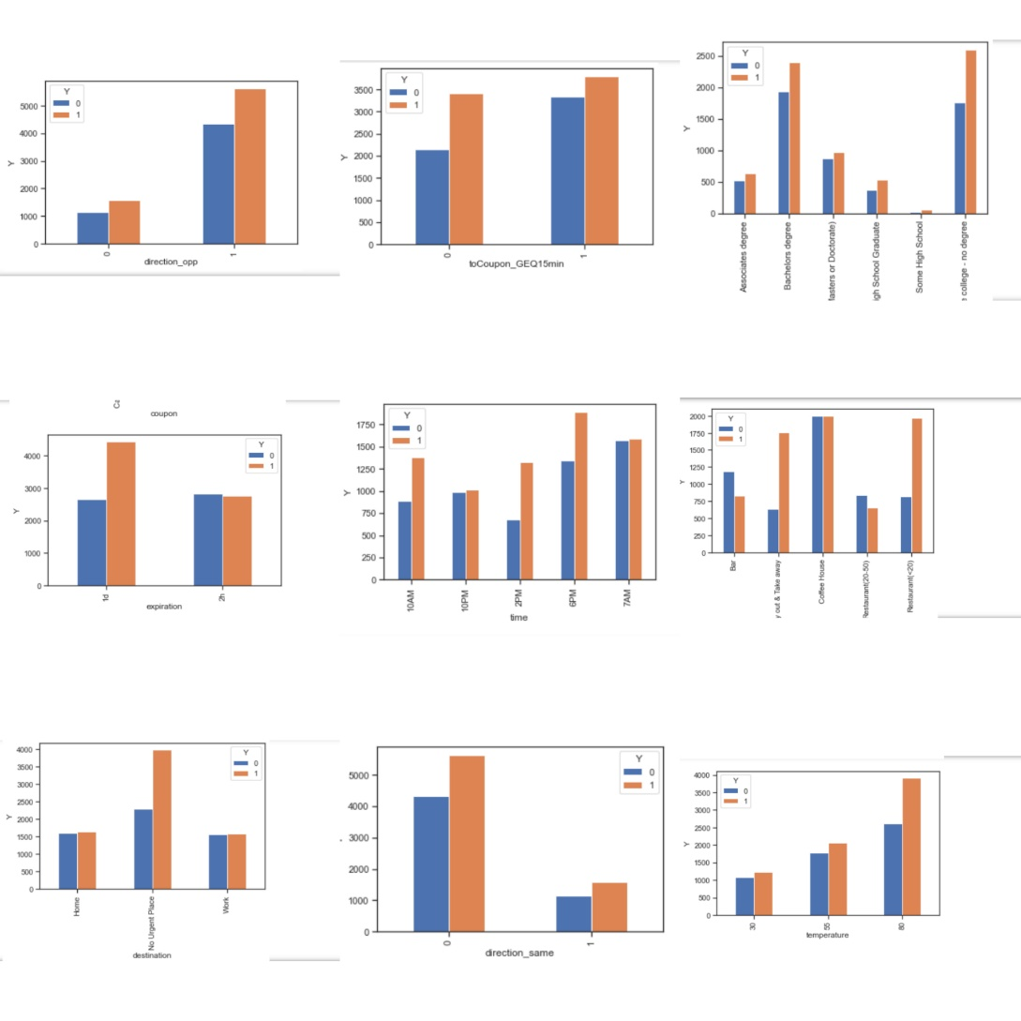
Results and Discussion

Slide 25
Conclusion
Machine learning techniques are widely used data analysis methods in various business and industrial sectors. The main reason for that because ML can build predictive models to produce better predictions and achieve the desired level of accuracy, leading to better outcomes. Building the models is an easy and straight forward process. The main challenges in data analysis are data preparation and cleaning, the selection of appropriate models and attributes used in their implementation.

Slide 26
Conclusion
The aim of the project is how to use supervised learning techniques for analysis and making predictions using existing dataset in Recommender system. To find how they can be used together in a process of converting raw data to effective decision-making knowledge. Thus, in this project are used decision tree algorithms to predict a person will accept the coupon if he is the driver. As per the model, model score is 0.69.

Slide 27
References
 | 1. Francesco Ricci, Lior Rokach and Bracha Shapira. Introduction to Recommender Systems handbook. Springer, 2011. 2. "How to split data into three sets (train, validation, and test) And why? | by Samarth Agrawal | Towards Data Science" https://towardsdatascience.com/how-to-split-data-into-three-sets-train-validation-and-test-and-why-e50d22d3e54c 3. "Machine Learning in Coupon Recommendation | by João Felipe Guedes | Towards Data Science" https://towardsdatascience.com/machine-learning-in-coupon-recommendation-2bdae281d840 4. Cognibot Machine learning. 5. Siraj Ravel You tube.

